Slide 1




Pima community college-west atmospheric particle collection Project: Electronics
ASCEND! FLIGHT 22 / ANSR FLIGHT 97
Electronics Team
Roslyn Norman
Noelia Parraz
Jonathan Parker
Kyle Gordon
Notes:
Speaker: Dr. Silvia Kolchens

Slide 2
Electrical goals
FALL SEMESTER
Rotate particle collection wheel at specific intervals using:
  Arduino Nano
  BMP180 altimeter sensor
  Hall effect sensor
  Altered servo motor
SPRING SEMESTER
Rotate particle collection wheel at specific intervals using:
  Arduino Uno
  BMP180 altimeter sensor
  Stepper Motor / Driver
Collect ozone data
Collect comparative altimeter date using Parallax sensor
Notes:
Speaker: Kyle Gordon
Talk about the differences between the semesters. ( Arduino Nano v Arduino Uno )
How the Servo was Altered.
(Stepper v Servo)

Slide 3
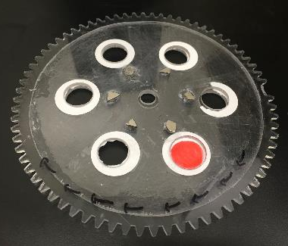
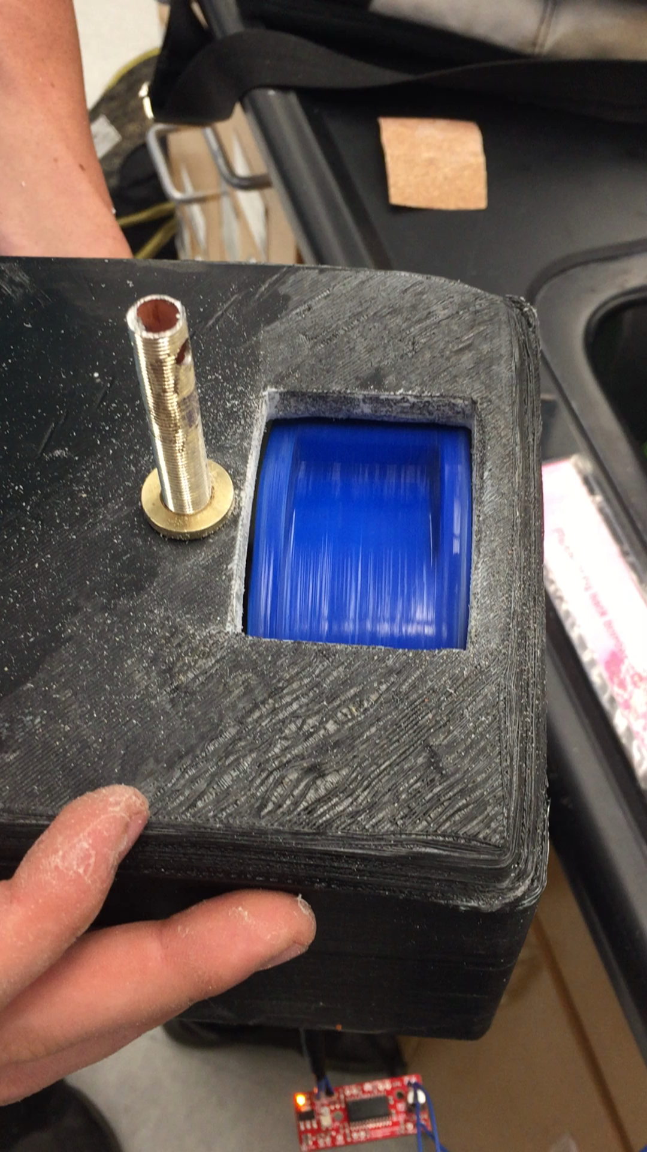
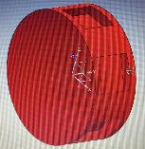
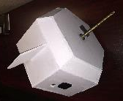
FALL SEMESTER
SPRING SEMESTER

Slide 4
Fall semester data
Balloon Burst
Power Loss
Notes:
Speaker: Roslyn Norman
Launch Time –30mins after powered on
Max – 74,000FT (same as actual within a few hundred feet) –1.5hrs into flight
Power Loss – 26,000FT (parachute deployment) --2hrs into flight

Slide 5
Fall semester data
Launch Time
Balloon Burst
Notes:
Temp Sensor was inside the payload
Temp Max: 66F / 19C (above inversion layer) – 16,000FT –42mins into flight
Temp at time of burst: -15F / -26C
Temp Min -31F / -35C –26,000FT –2Hrs ( colder b/c more air flowing through payload ) → About the temp in Chicago in winter

Slide 6
Fall semester data
Launch Time
Balloon Burst
Notes:
Close to vacuum conditions at apex

Slide 7
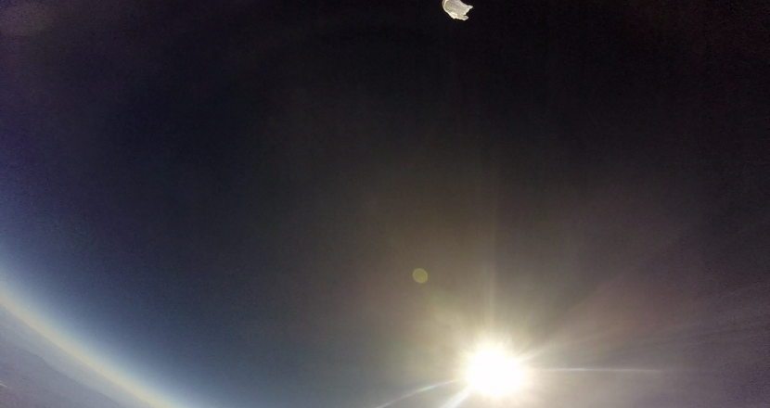
Balloon Burst

Slide 8
Spring semester data
DATA COLLECTION COMPROMISED BY ELECTRICAL FAILURE
WHY THE CIRCUIT FAILED:
Circuit was overloaded.
Too many components drawing power from a single Uno board caused the processor to overheat and shut down.
Notes:
Speaker: Jonathan Parker

Slide 9
conclusions
FALL SEMESTER
Experiment considered successful.
Data collected- accurately depicted ascent / descent.
Particle samples from each atmospheric interval were collected and analyzed successfully.
SPRING SEMESTER
Using stepper motor is more accurate than servo motor / hall effect set up, but draws more power.
Need more than one micro processor to run all components.
Notes:
Speaker: Noelia Parraz

Slide 10
ACKNOWLEDGMENTS
Tim Swindle (Space Grant Director)
Susan Brew (Space Grant Manager)
Jack Crabtree (ANSR)
Silvia Kolchens (PCC Mentor)
ANSR Volunteers
Xerocraft, Hacker Space

Slide 11
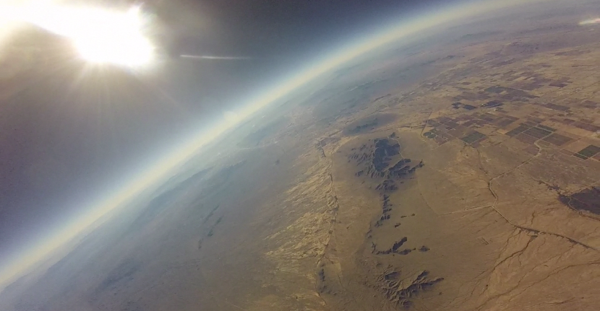
Questions?

